Slide 1
Portability Transactions Data Analysis
One Nation One Ration Card (ONORC) - Data Insights
K . Bhaskar
2211cs010273

Slide 2
Introduction to ONORC Data
• The dataset contains portability transactions under the One Nation One Ration Card (ONORC) plan.
• Facilitates seamless access to ration benefits across states.
• Released under the National Data Sharing and Accessibility Policy (NDSAP).
• Contributed by the Ministry of Consumer Affairs, Food, and Public Distribution.

Slide 3
Dataset Overview
• Contains 329 records with 7 attributes.
• Includes both numerical and categorical data.
• No missing or duplicate values.
• Memory-efficient (~0.055 MB).

Slide 4
Key Data Columns
• homestatename: State where transaction originated.
• salestatename: State where ration was claimed.
• txn_count: Number of transactions.
• month & year: Transaction time period.

Slide 5
Insights from Data
• Some states have higher transaction counts.
• Data helps analyze migration patterns.
• Useful for government policy planning and resource allocation.

Slide 6
Data Visualization Approach
• Used Pandas, Matplotlib, Seaborn for analysis.
• Charts to show state-wise transaction patterns.
• Helps in better understanding of trends.

Slide 7
Conclusion
• ONORC ensures ration portability across states.
• The dataset provides valuable insights into migration trends.
• Useful for policy-making and improving food distribution systems.

Slide 8
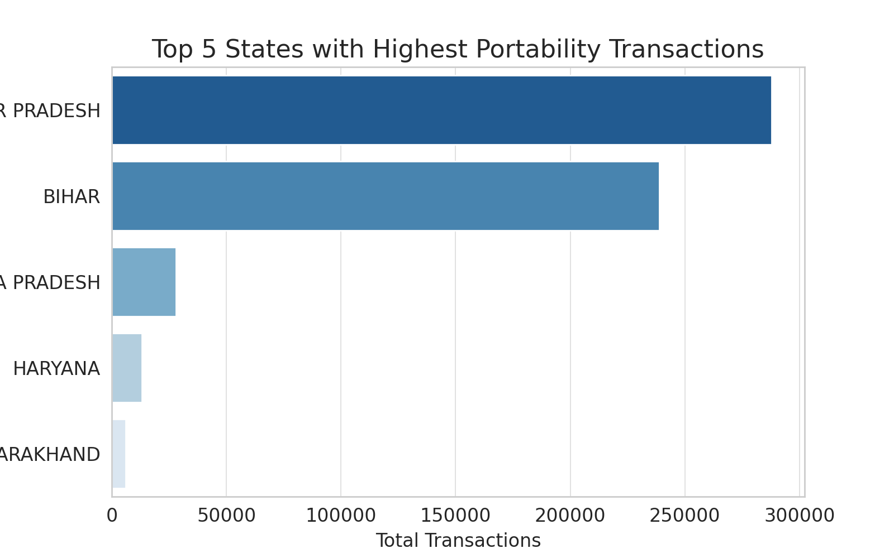
Bar Graph: Top 5 States with Highest Transactions
This bar graph represents the top 5 states with the highest portability transactions under ONORC, helping visualize state-wise trends in portability usage.

Slide 9
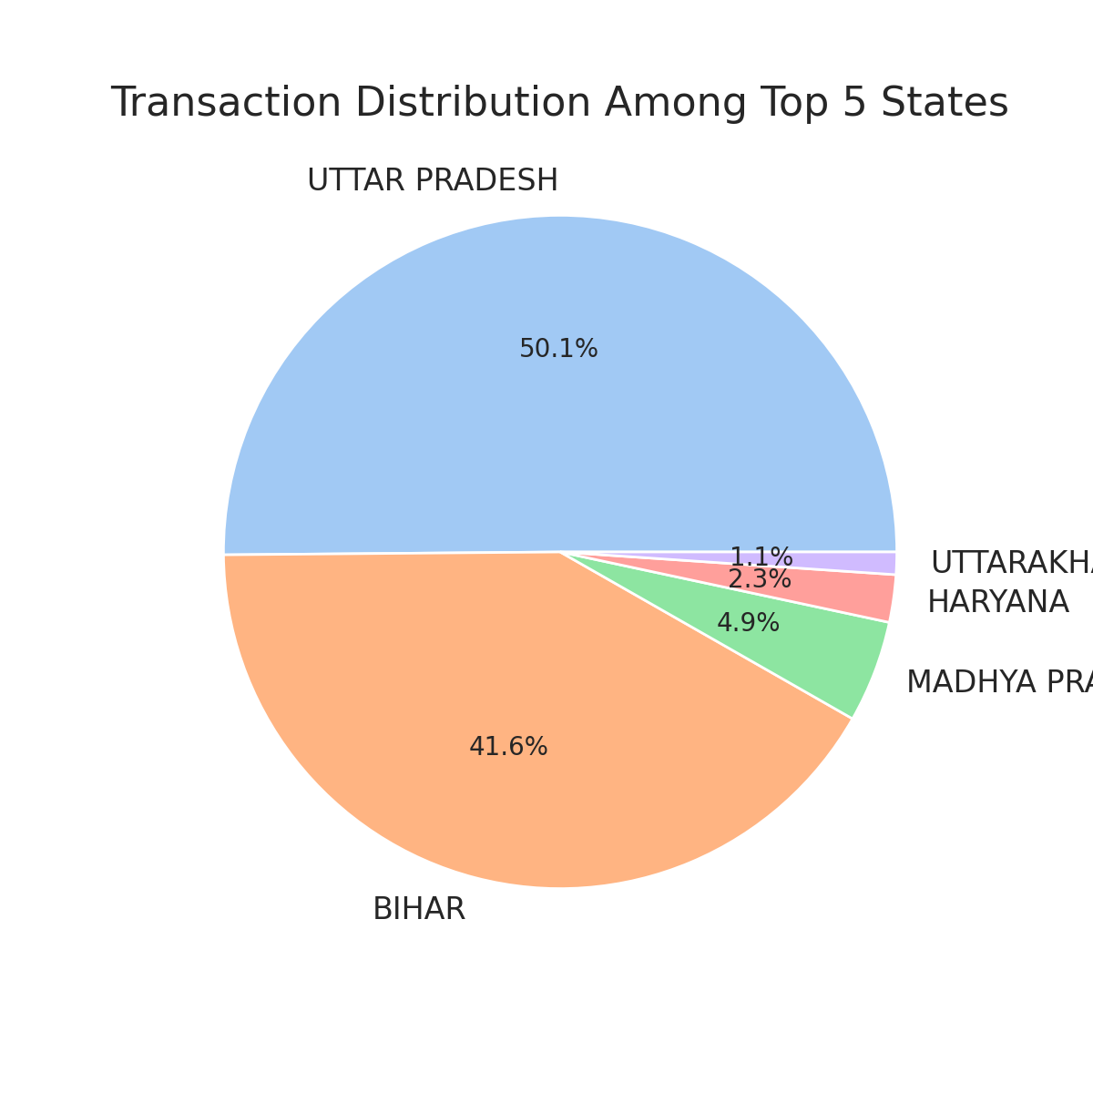
Pie Chart: Transaction Distribution
The pie chart displays the proportion of transactions among the top 5 states. It provides insights into which states contribute the most to portability transactions.

Slide 10
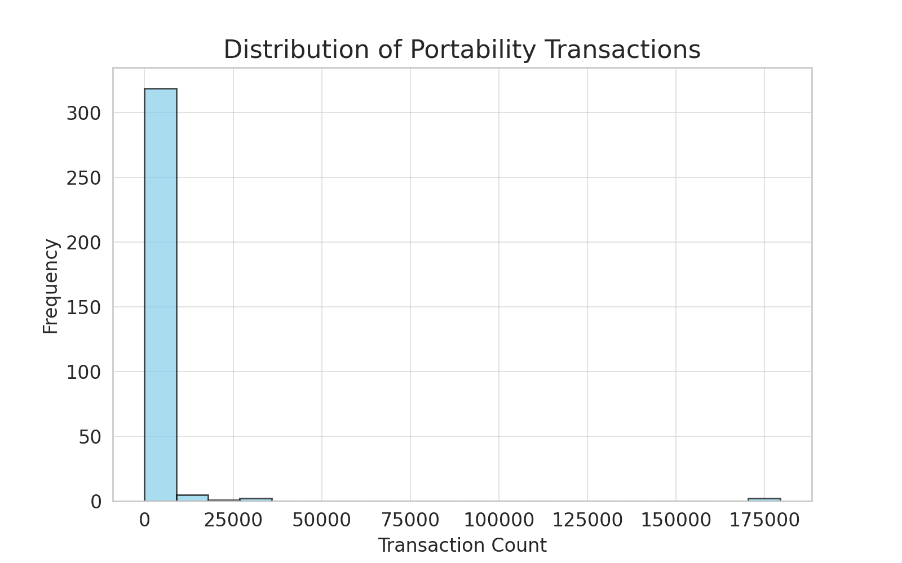
Histogram: Distribution of Transactions
The histogram shows the distribution of transaction counts across all records. It helps identify the frequency of different transaction volumes, highlighting key trends in portability usage.

